Slide 1
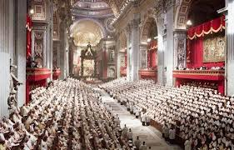
We are at more
than 50 years since
the Second Vatican
Council. We live in times that cause anxiety for Religious Life, especially in the Western world.

Slide 2
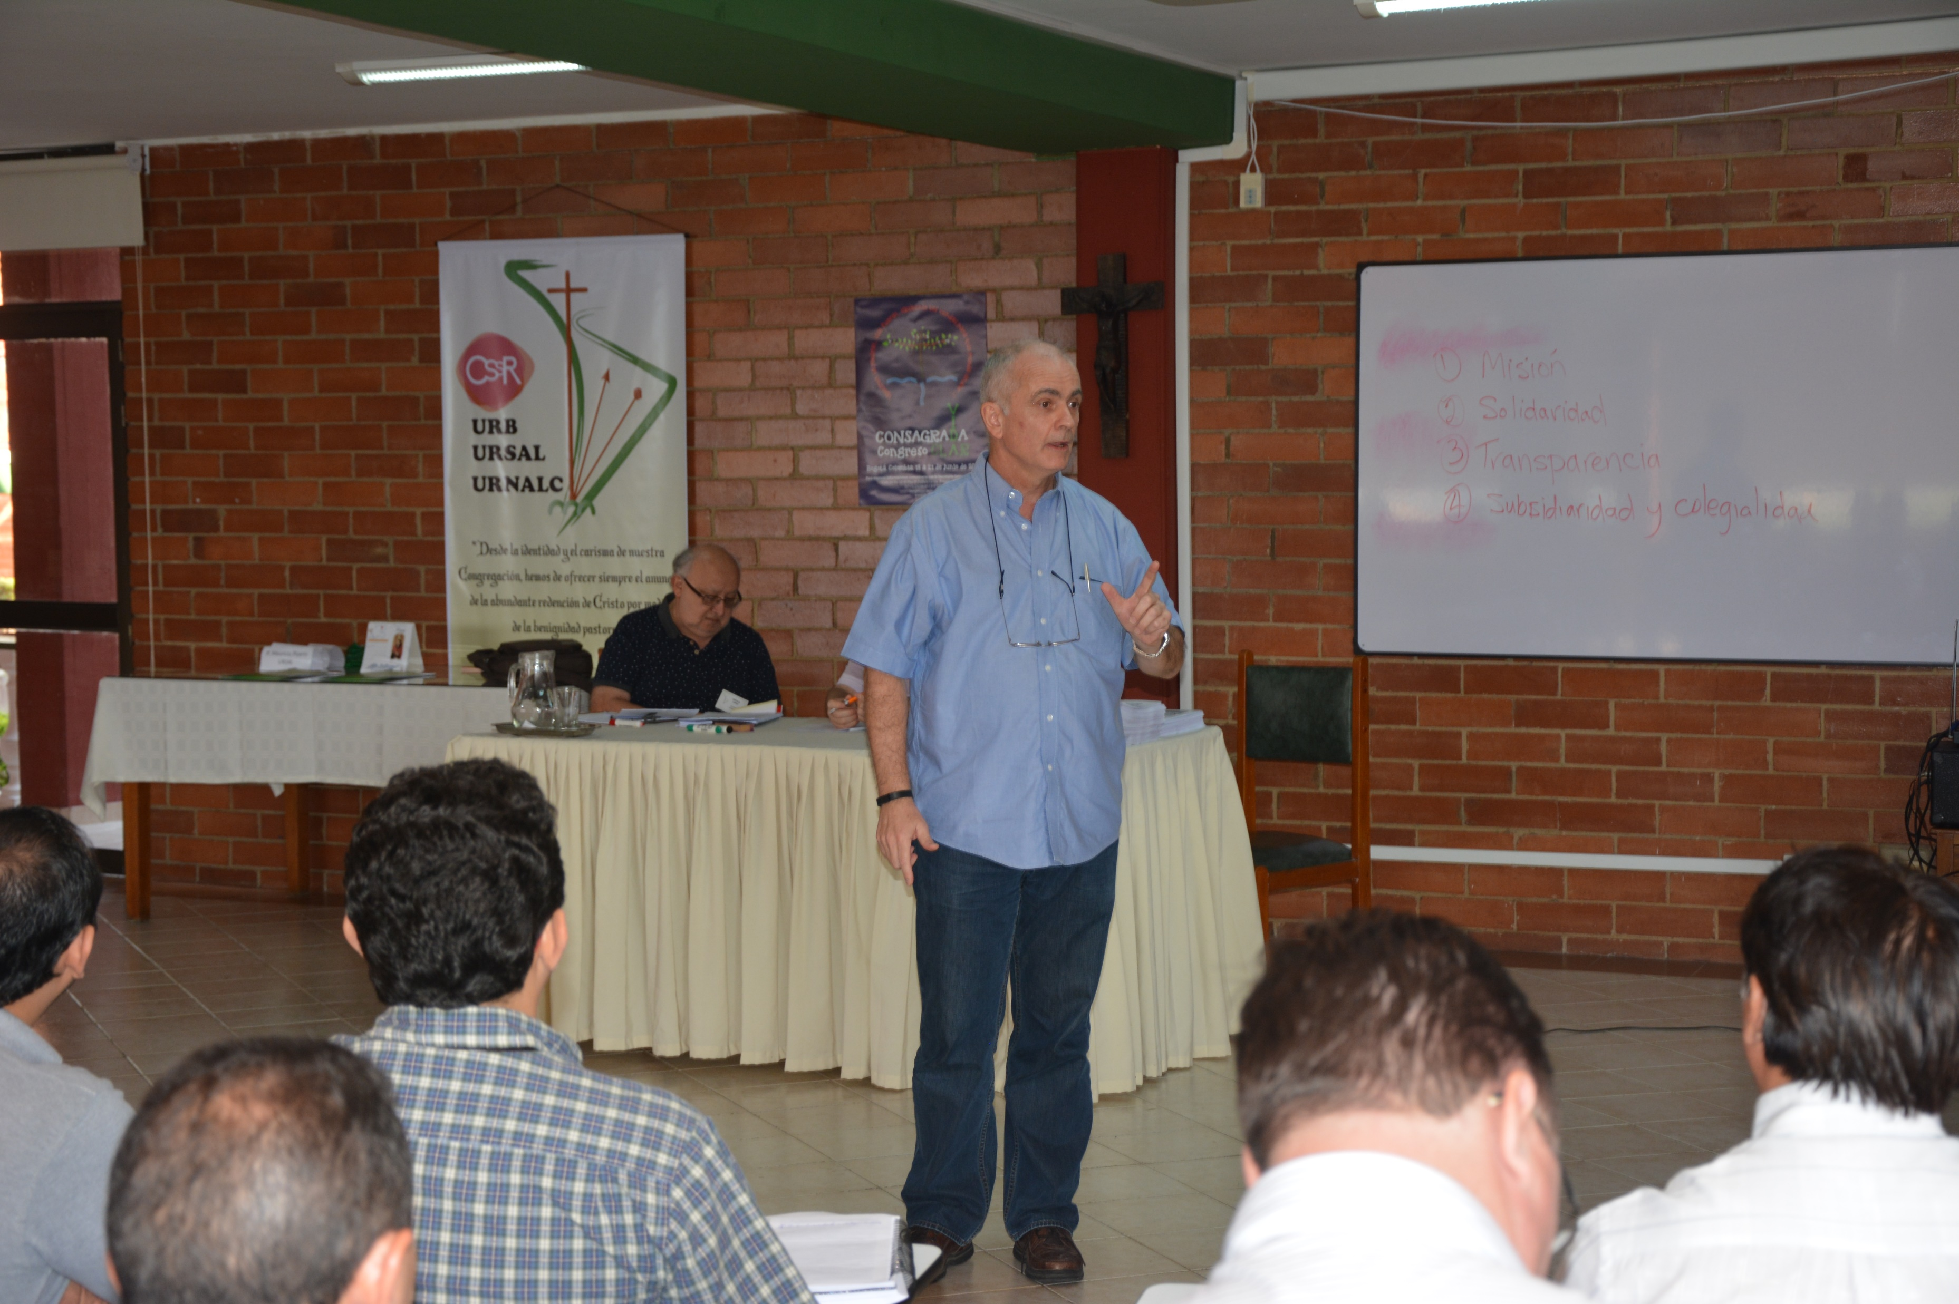
“It is true that it is a time of epochal change, of a clash of civilizations, uncertainty, and fear…”
(Father General, Michael Brehl,
in the booklet of the Final
Documents of the XXV
General Chapter writes in the
Preface, p. 12.)

Slide 3
“…although Consecrated Life is going through an important crisis…” (message of the Capitulars,
XXV General Chapter, to the Congregation, p. 18)

Slide 4
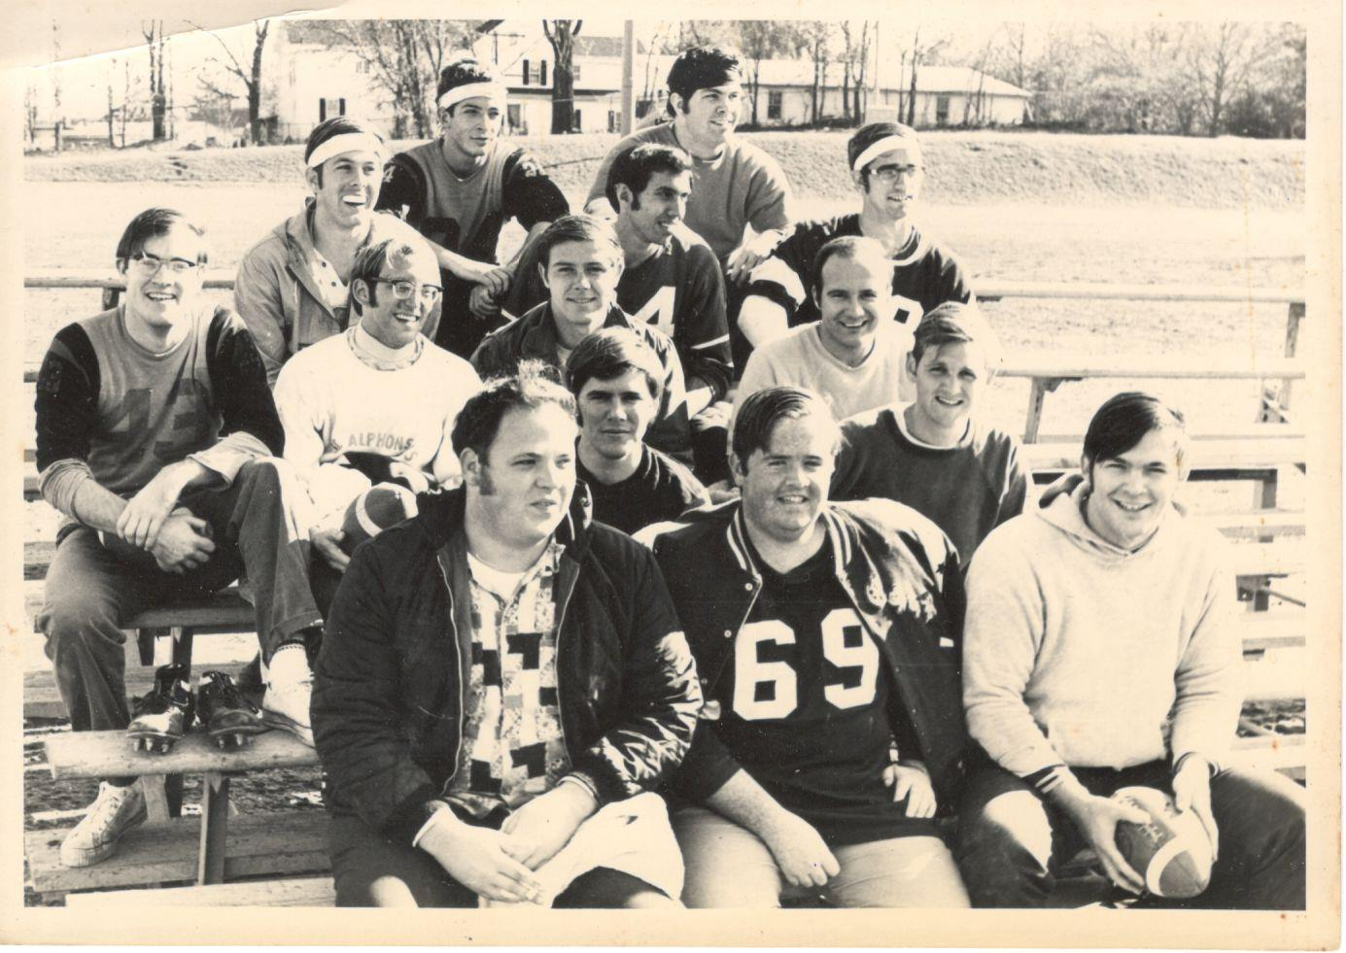
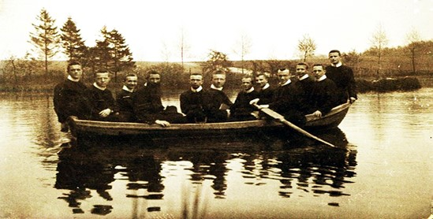
The reality of the
aging of our members
There has been a drastic
reduction of vocations and
the abandonment by many

Slide 5
- difficulty in maintaining traditional works (colleges and universities, hospitals, homes,
parishes, pastoral
and social centers,
missions) due to
lack of personnel
and lack of economic resources

Slide 6
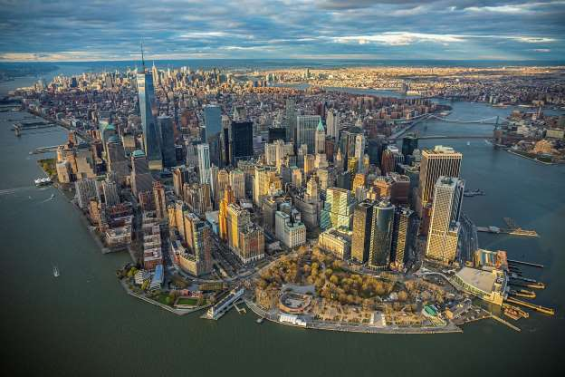
Perhaps another source of anxiety is
the giving back
of missions and
even the sale of properties.

Slide 7
The fact that certain churches are no longer necessary "should be received in the Church not with anxiety but as a sign of the times that invites us to reflect and forces us to adapt."
The Pope comments that there is a constant Church teaching that the goods of the Church do not have an absolute value and that decommissioned Churches and properties should be destined for the poor rather than to commerce (message of Pope Francis to the Vatican sponsored Congress in Rome, November, 2018, “God does not live here anymore”, on the sale and use of Church properties).

Slide 8
It is interesting that in Germany more than 500 churches were closed in the country between 2000 and 2017. One third were demolished, and the rest sold or destined for other uses, unfortunately among the other uses are garages, discos, ice cream parlors, etc.

Slide 9
In Holland, it is estimated that two-thirds of the 1,600 Catholic churches will be closed in the next 10 years.

Slide 10
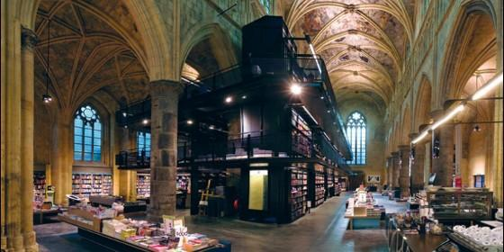
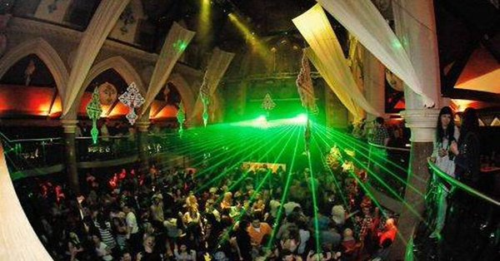
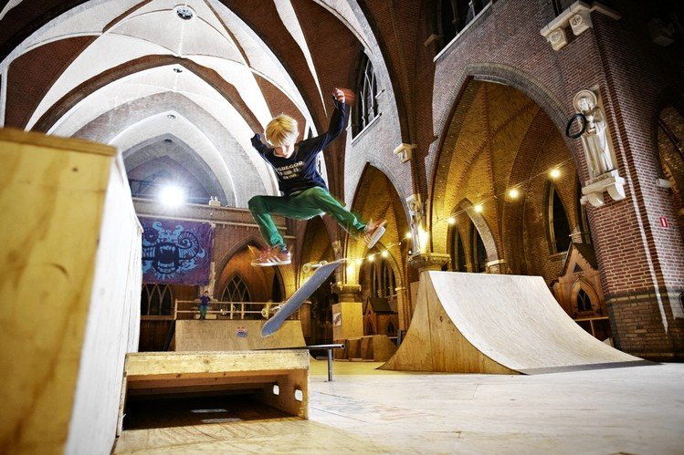
In Holland, the Church looses 267 followers
each day; 100,000 each year.
Each week a another Parish closes.
The buildings have been
used for:

Slide 11
Also, a dimension that touches us directly as a clerical
Congregation: the overcoming of models that have
been called the “exaggerated centering on the priest,
the temple and the altar”
(cf. digital book, Sueños de un viejo
teólogo, Una Iglesia en Camino,
Vitor Codina, S.J.)
…and remember that,
in the Church, we are all equal, that is,
WE
as well as you!...

Slide 12
Worthy of mention as a cause for anxiety is all that has happened as far as the protection of minors and vulnerable adults, which is an issue that is far from over and will continue to affect us well into the future.

Slide 13
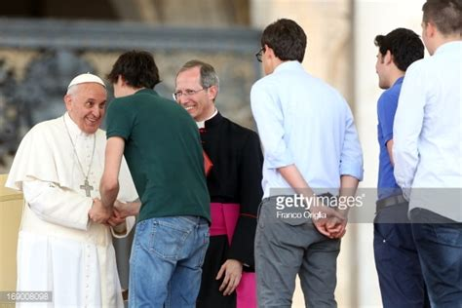
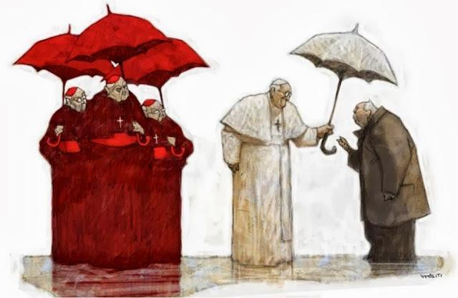
At the same time, new
lay ecclesial movements
are emerging that have
hierarchical support,
while Religious Life seems to be dying.
The question has been asked:
Has the time of Religious Life
already passed in the Church?

Slide 14
Causes of what can be considered a crisis (XXV General Chapter):
we can too easily resort to very simplistic and superficial reasons, for example, a perceived lack of missionary zeal, availability, commitment, authentic and joyous testimony of its members.

Slide 15
Without this being totally false, it is not the
ultimate explanation
of the current crisis.

Slide 16
We must recognize that there are historical and structural roots of the current crisis of the Church, for example, the new paradigms, the
change of epoch (not an epoch of
change as explained by John Paul II),
accompanied by the profound
social, economic, technical, cultural, and religious changes that society has undergone in recent decades that naturally affect Religious Life.

Slide 17
As Religious, we cannot be overcome by these profound changes;
we cannot use the expression
of Pope Benedict XVI on
renouncing the pontificate,
which can be a summary of
what is being experienced
by many during these global changes,
“I have no more strength.”
“I have no more strength.”

Slide 18
ANXIETY:
A NEW CUADRENNIAL
NEW CUADRENNIAL APPOINTMENTS
RESTRUCTURING AND RECONFIGURATION

Slide 19
“What are my (intelligent, wise, prudent, inspirited, saintly) superiors going to do with me now?”
In my personal experience,
at times I thought them very wise
and inspired, but admittedly, at other
times, (as I grow older) I have felt
very confused by their decisions!!!
“Where are they coming from?”
“How dare they challenge my comfort zone!!!”

Slide 20
DON’T BE ANXIOUS,
DON’T BE AFRAID,
LET ME SURPRISE YOU!

Slide 21
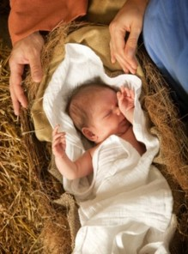
GOD’S SURPRISES:
Throughout history the Lord has continually surprised humanity.
The Scriptures which we prayed and reflected on this
past Advent and Christmas Season spoke to us of
many of God’s surprises.
When Our Savior became man and arrived among us
two thousand years, the only ones who knew about
it were Mary, Joseph, some shepherds and Kings from
the Orient. God, our Father, surprised mankind with this special gift of the birth of his only Son.

Slide 22
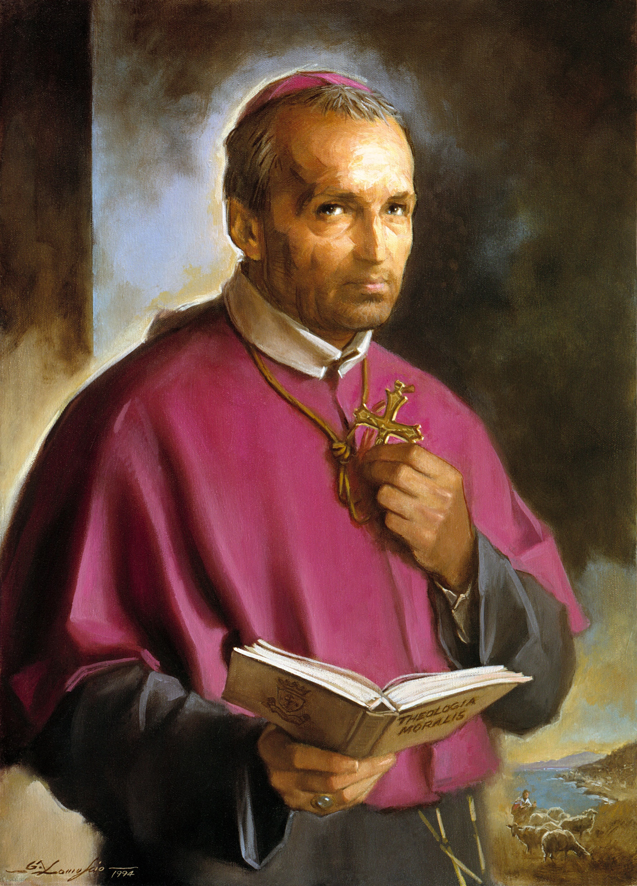
God surprised
Saint Alphonsus
leading him to be
the founder of a
Religious Missionary
Congregation.

Slide 23
God, our Father, continues to surprise
us but needs that we put ourselves in
his hands and
ALLOW HIM TO SURPRISE US
personally and as a group.
We Religious live in times of much anxiety
and justifiably for many reasons.
Nevertheless, unhealthy anxiety and worry
are certainly contrary to what God´s wants
for us, that is, He created us and wants us
to be free and joyful.
Wouldn´t be easier if you just let it go?
the PAST

Slide 24
We cannot and should not let anxiety and negative emotions define these times which we are living and intimidate us, but rather we
who are living these present
times with all its confusion
and anxiety should be defined
as faithful, hopeful, joyous,
confident and prophetic men
with inner peace always open to letting the Lord surprise us.

Slide 25
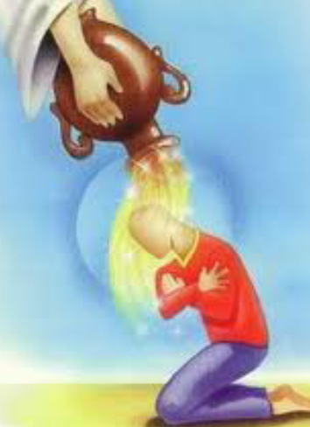
Living faith and the hope-filled
attitude of
LETTING GOD
SURPRISE US,
besides being a powerful
testimony to the people
we minister to,
gives us much peace and freedom.

Slide 26
“Today St. Paul exhorts us not to worry about anything, but in all circumstances to place before God our requests, our needs and our concerns (Phil 4,6). Let us be aware that in difficulties we can always turn to the Lord and that He never rejects our supplications. This is a great source of joy for us.
There does not exist any worry, fear or anxiety that can ever take away from us the serenity that comes, not from human things and human consolations, no, no, the serenity that comes from God in knowing that God always lovingly guides our life, also during problems and sufferings. This certainty nurtures hope and courage. To receive the Lord's invitation to joy, we need to be a people willing to question ourselves. But what does this mean? Like those who, after listening to the preaching of John the Baptist, asked him: You preach like that but "What can we do?" "What should I do?" (Lk 3, 10). This question is the first step in the conversion to which we are invited in this time of Advent. Each of us wonders: What can I do? What should I do? May the Virgin Mary help us to open our hearts to the God who comes, so that He may flood our entire lives with joy. And then you will not be afraid of anything. In the presence of the Lord, our hearts are always joyous.”
(Pope Francis and his words at the Angelus on the III Sunday of Advent, December 16th, 2018)

Slide 27
I invite you to reflect on:
What realities (personal, communal, Religious Life, social, etc.) cause in you a certain amount of ANXIETY?
Does the thought,
“Let the Lord surprise you”
resonate with your personal experiences?

