Slide 1
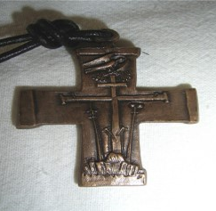
Presentation
RATIO FORMATIONIS GENERALIS
updated in 2020

Slide 2
1. The situation of formation today in the Congregation

Slide 3
An era of global change: social, economic,
cultural, affecting the faith, the Church and Consecrated Life
Status of the Redemptorist Mission today, 64% in
Parishes and Shrines
Restructuring (Reconfiguration, new Provinces)

Slide 4
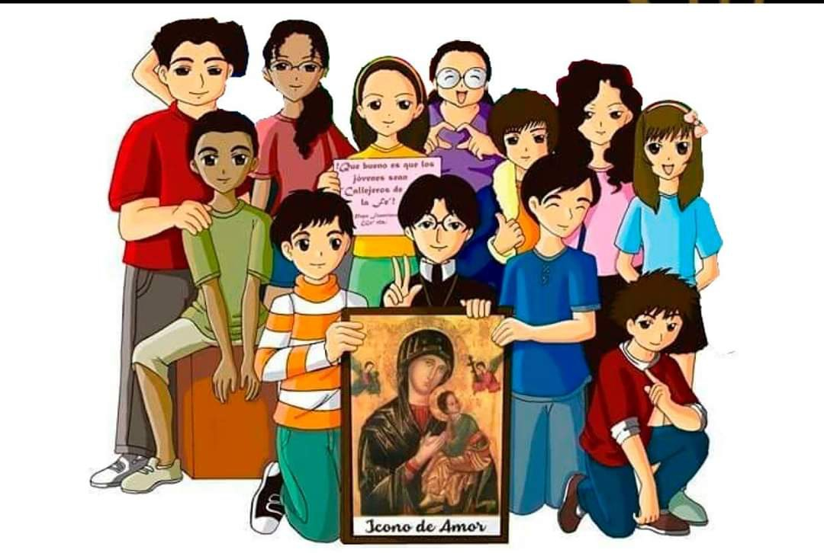
Conferences and interprovincial formation
Few units can do by themselves the whole formation process
The need for more
collaboration by all

Slide 5
Few Redemptorist academic centers
A big challenge: few prepared, stable formators
Many Units with few vocations and formandi
Many studies are done at Universities, Diocesan Seminaries, etc.

Slide 6
2. Before
this RFG,
updated in 2020

Slide 7
Different Ratio: Brothers, Continuing formation, etc.
The (2003) Ratio
The Decree of the General Government on Formation
(2015)
Decision No. 30 of 25th General Chapter and the evaluation asked of the formation programs

Slide 8
3. Main documents that have been included

Slide 9
Various Vatican documents:
Evangelii Gaudium (2013)
Ratio Fundamentalis
Institutionis Sacerdotalis (2016)
Gaudete et Exsultate (2018)
Youth Synod (2018)
This photo of unknown author is licensed by CC BY-SA

Slide 10
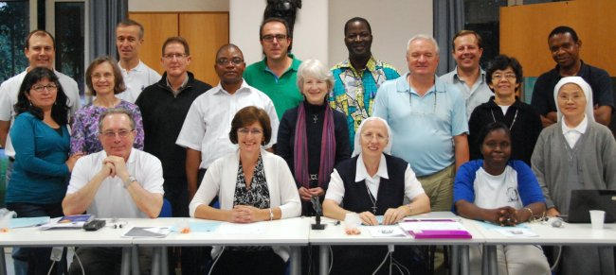
Congregation for Consecrated Life:
Starting afresh from Christ (2002),
Year of Consecrated Life (2014-15)
New Wine in New Wineskins (2018)
This photo of unknown author is licensed under CC BY-NC-ND

Slide 11
4. Structure

Slide 12
Rescript of approval
Letter of Father General,MichaelBrehl
Profile of the future Redemptorist, 25th General Chapter (2009)
General introduction

Slide 13
Chapter 1: Formation in the
Congregation
Chapter 2: Basic Principles
of our Vita Apostolica
Chapter 3: Agents and Others
formation elements
Chapter 4: Practical design for
the 8 stages

Slide 14
Appendices:
Decree G.G. 2015
Letter from Fr. Juan Manuel Lasso de la Vega, Superior General emeritus
Attachments:
Personal accompaniment,
Persons with homosexual tendencies,
Admission, dismissal and abandonment,
Protection of minors
Online bibliographic references
C.Ss.R. formation website : www.cssr.news/formation

Slide 15
5.- Formation Stages

Slide 16
Vocational promotion and accompaniment (including «mature vocations")
Formation before the Novitiate (Candidates)
Novitiate (Novices)
The period from Temporary to Perpetual Profession (Temporary Profession)
(Formation for the Brothers)

Slide 17
5. Pastoral experience stage during temporary profession.
6. Preparation for Perpetual Profession
7. Transition to Ministry,
8. Continuing Formation

Slide 18
Aspects to be
highlighted

Slide 19
Living the Redemptorist Missionary Charism and
the preparation to become authentic missionaries
Help both students and confreres to live fully their lives, in human and Christian maturity, in the following of Christ, together with the poor and most abandoned (Const. 78)
To live fully our Vita Apostolica (Const. 1) “which comprises at one and the same time a life specially dedicated to God and a life of missionary work”.

Slide 20
New aspects of the formation program:
Interculturality, # 29
Restructuring, # 30
Interconferencial, Interprovincial and International, # 31
In Shared Mission with the Laity, # 45
Agents and other formation elements
The formand himself, # 59
The Secretariats of the Units and Conferences, # 70
The Council or "Board" of the Interprovincial Formation houses, # 71

Slide 21
New stages:
Vocation ministry and Accompaniment, # 90
Before Novitiate, # 102
Pastoral experience stage, # 130
Specialized formation for the mission of the Unit, # 162
Ratio, Directory, Program, Agreements and Contracts, # 21

Slide 22
7.- Conclusion

Slide 23
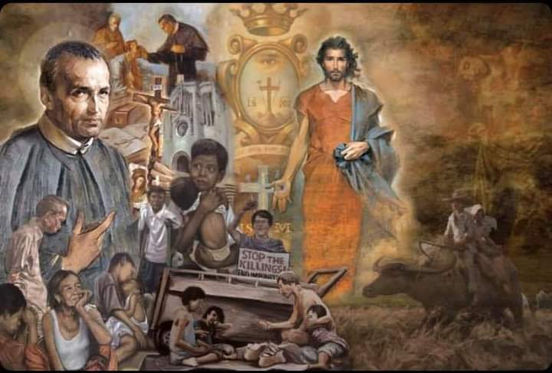
We become every day a Congregation with a broader universal mission
Some propose a completely new Ratio…
The conferences are doing their Ratio
The importance of the official languages and the particular languages for the mission

