Slide 1
The protection against the sexual abuse of minors and vulnerable adults, and how to deal with processes of prevention.
Fr. Gideon Sidinga CSsR

Slide 2
Protection against the sexual abuse of minors and vulnerable adults
A holistic protection of minors and vulnerable adults should take the systems in this diagram seriously.
All the players in the diagram are responsible to either protect/ safeguard children and vulnerable adults from sexual abuse or they can be perpetrators in covering up or in creating systems which help in perpetuating more abuses.
I am talking about systems in various institutions including our institutions within the Church.
How can systems become protective factors which help to prevent sexual abuses to happen or how can systems in various institutions promote more sexual abuses to happen?
Church

Slide 3
Risk assessment in Safeguarding minors and vulnerable adults from sexual abuse
What are risk factors?
Risk factors are characteristics which are associated with an increased statistical risk of sexualized violence.
Risk factors for child maltreatment are the measurable circumstances, conditions or events that increase the probability that a family will have poor outcomes in the future.
In the case of an accumulation of risk factors , there is an increased likelihood of sexual abuse for children.
It does not mean that children will definitely be victims of sexual abuse! But if risks are high that signals to the greater risk for children and vulnerable adults to be sexually abused.

Slide 4
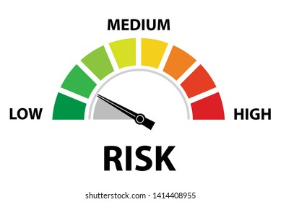
How to come up with protective measures to protect minors and vulnerable adults against the sexual abuse?
Risk assessment should be done at every institution or religious house to find out if the set up of the institution can increase the risk which can lead to actual sexual abuse.
Risks can be classifies in the following categories:
This means that attention should be given
To all these classes of risks in order to avoid
an abuse to happen,
Once this is done then protective factors can now
be put in place according to the risks assessed.
This process ensures a long term protective measures.

Slide 5
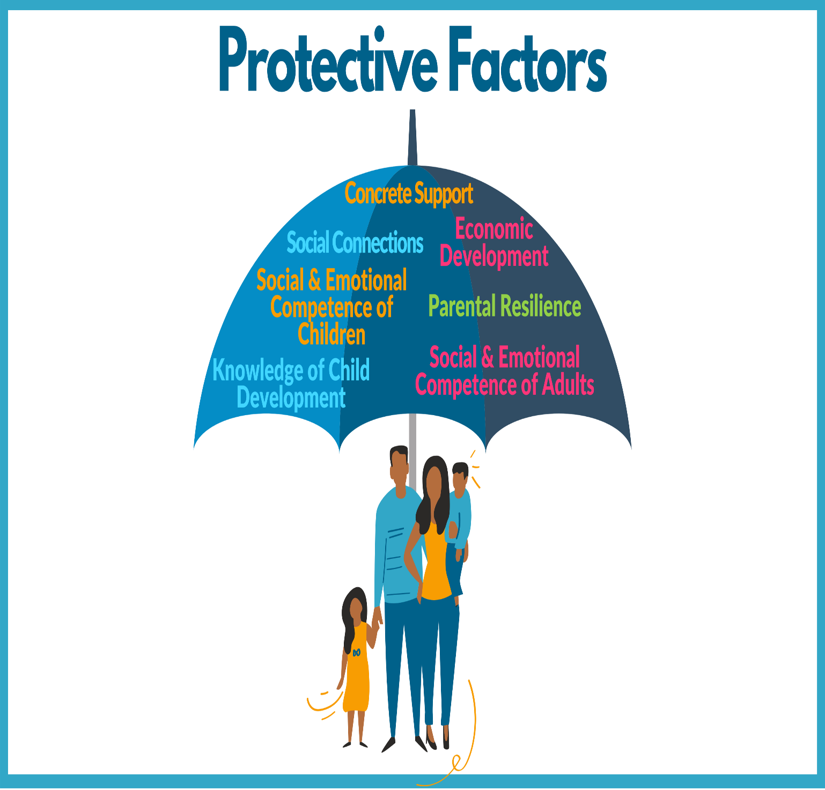
What are protective factors?
Protective factors are characteristics which are associated with a healthy development in spite of adverse events and aversive conditions. Depending on
time
persons
situation
resources
Protective factors are attributes or conditions that can occur at individual, family, community or wider societal level.
Protective factors
moderate risk or adversity and
promote healthy development and
Child and family wellbeing

Slide 7
Protective Factors
creativity

Slide 8
Protective Factors
Necessary documents should be developed and put in place in order to prevent abuses of minors and vulnerable persons:
Policies and Standard Operating procedures.
Codes of conducts.

Slide 9
Why do we need child safeguarding/protection policies in our institutions and in the church?
Simply put, a child safeguarding/ protection policy helps create a child-safe environment in an institution/ church.
It is designed to safeguard/ protect children and vulnerable persons from abuse and exploitation by staff and any member of the Church.
Child Safeguarding policy provides guidance and lay out a just process for handling allegations.

Slide 10
What is a child safeguarding/ protection policy (CPP) and why do we need it?
A child protection policy describes:
the safeguarding measures that are in place to protect children
the rules on how to behave when working directly with them
how to protect children from abuse and harm
who to report to if any issues arise
how to respond to the situation in an appropriate manner.

Slide 11
Such a policy gives children/young people and parents useful information about how an institution will handle these issues, guides all its employees in their daily work and makes the institution accountable.
It also protects the staff, including volunteers and trainees.
It must be publicly available (on the institution’s website), clearly written and accessible and endorsed by all employees and management

Slide 13
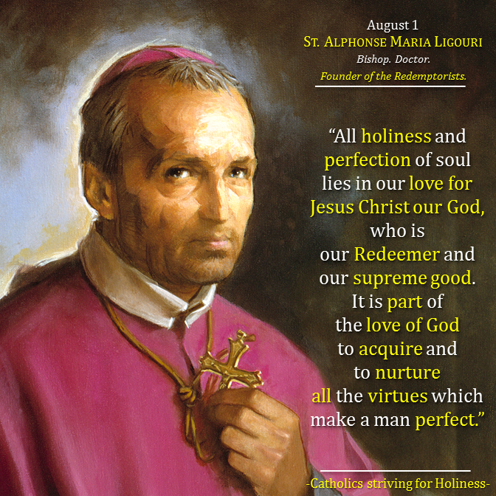
THANK YOU!

